Slide 1
11/18/22

Slide 2
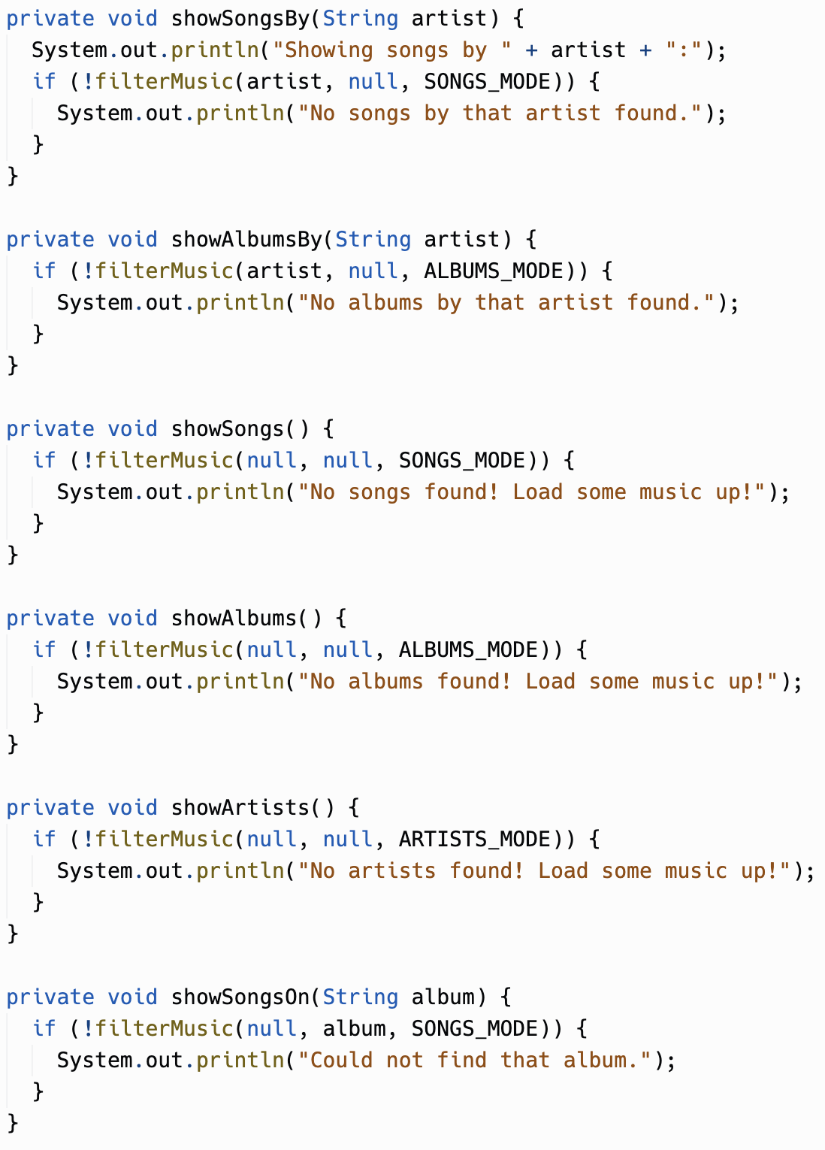
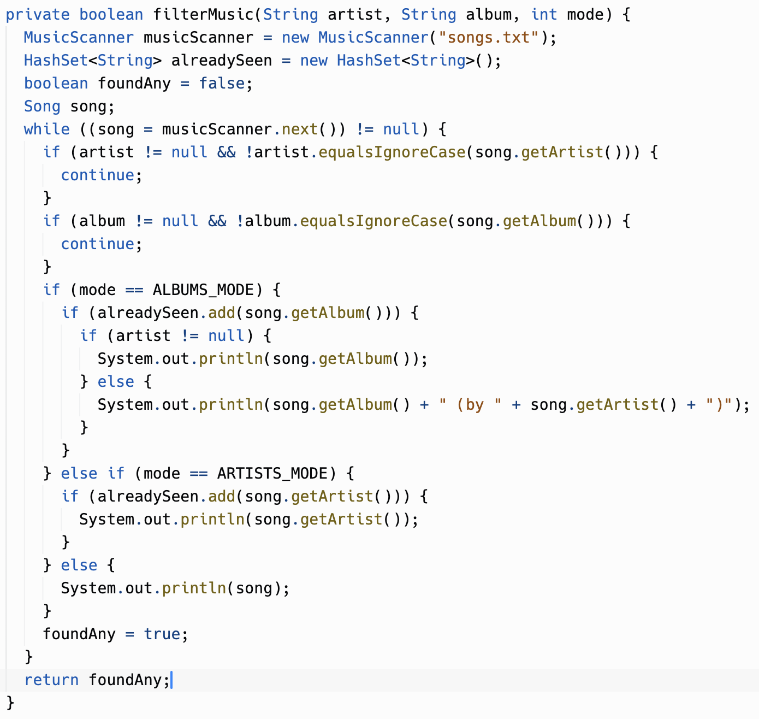
Replit Notes: MusicCollection

Slide 3
Sections 5.7, 5.8, 5.9
Statics
Scope and Access
this

Slide 4
Statics
Static variables & methods belong to Classes - not Instances of a Class
There is only one copy of a static variable & method
They can be public or private
Static variables & methods are accessed using the name of the class to which they belong and a dot (.) With a couple of exceptions: Statics accessing statics; And static imports
Math.PI
Math.random()
Math.sqrt()
The main() method is a static method - It is only ever run one time for a program - And the JVM needs to run it without creating an Instance of a Class

Slide 5
Statics
Static variables & methods are accessed using the name of the class to which they belong and a dot (.)
Exception A static can invoke another static without the class name prefix
class Population { public static int getNumAdults() { return numAdults; } public static int getNumChildren() { return numChildren; } public static int getPopulation() { return getNumAdults() + getNumChildren(); } }
Population.getNumAdults();
Population.getNumChildren();
Population.getPopulation();

Slide 6
Statics
Static variables & methods are accessed using the name of the class to which they belong and a dot (.)
Exception Recall from Section 2.9 that static imports can be used to pull in statics from another package to your default scope - which you can then invoke without the Class name
import static java.lang.Math.*;
public class Main {
public static void main(String args[]) { System.out.println(PI); System.out.println(sqrt(9)); } }

Slide 7
Statics
Statics can directly access other Statics
Statics cannot directly access non-Statics
Non-Statics can directly access Statics

Slide 8
Statics
Statics can directly access other Statics
Statics cannot directly access non-Statics
Non-Statics can directly access Statics
class Person { private static int numPeople = 0; private String name; public Person(String initName) { numPeople++; name = initName; } public static int getNumPeople() { // System.out.println(name); return numPeople; } public void report() { System.out.println(name + " is one of " + numPeople + " people"); } }

Slide 9
Statics
Person.getNumPeople(); A> ?
Statics can directly access other Statics
Statics cannot directly access non-Statics
Non-Statics can directly access Statics
class Person { private static int numPeople = 0; private String name; public Person(String initName) { numPeople++; name = initName; } public static int getNumPeople() { // System.out.println(name); return numPeople; } public void report() { System.out.println(name + " is one of " + numPeople + " people"); } }

Slide 10
Statics
Person.getNumPeople(); A> 0
Statics can directly access other Statics
Statics cannot directly access non-Statics
Non-Statics can directly access Statics
class Person { private static int numPeople = 0; private String name; public Person(String initName) { numPeople++; name = initName; } public static int getNumPeople() { // System.out.println(name); return numPeople; } public void report() { System.out.println(name + " is one of " + numPeople + " people"); } }

Slide 11
Statics
public static int getNumPeople() { // System.out.println(name); return numPeople; }
Statics can directly access other Statics
Statics cannot directly access non-Statics
Non-Statics can directly access Statics
class Person { private static int numPeople = 0; private String name; public Person(String initName) { numPeople++; name = initName; } public static int getNumPeople() { // System.out.println(name); return numPeople; } public void report() { System.out.println(name + " is one of " + numPeople + " people"); } }

Slide 12
Statics
Person p1 = new Person("Julie"); Person p2 = new Person("Bobby"); p1.report() B> ?
p1.getNumPeople();
C> ?
Statics can directly access other Statics
Statics cannot directly access non-Statics
Non-Statics can directly access Statics
class Person { private static int numPeople = 0; private String name; public Person(String initName) { numPeople++; name = initName; } public static int getNumPeople() { // System.out.println(name); return numPeople; } public void report() { System.out.println(name + " is one of " + numPeople + " people"); } }

Slide 13
Statics
Person p1 = new Person("Julie"); Person p2 = new Person("Bobby"); p1.report() B> Julie is one of 2 people
p1.getNumPeople();
C> 2
Statics can directly access other Statics
Statics cannot directly access non-Statics
Non-Statics can directly access Statics
class Person { private static int numPeople = 0; private String name; public Person(String initName) { numPeople++; name = initName; } public static int getNumPeople() { // System.out.println(name); return numPeople; } public void report() { System.out.println(name + " is one of " + numPeople + " people"); } }

Slide 14
The Singleton Pattern

Slide 15
Singleton Pattern
A way to ensure that one AND ONLY ONE Instance of a Class is created
Used to coordinate data and functionality across components of a software program
Overall can reduce the need for statics
No need to make every method a static when you can ensure that only a single Instance of a Class is ever created
Examples
Generate a unique identifier
Isolate and coordinate access to critical shared resources
Typically built with a static Factory Method and a private Constructor
Wikipedia: Singleton Pattern, Factory Function

Slide 16
Singleton Pattern
public class UniqueIdCreator {
private int uniqueId;
private UniqueIdCreator() {
uniqueId = 1;
}
public int getUniqueId() {
return uniqueId++;
}
private static UniqueIdCreator instance;
public static UniqueIdCreator getInstance() {
if (null == instance) {
instance = new UniqueIdCreator();
}
return instance;
}
}

Slide 17
Singleton Pattern
public class UniqueIdCreator { private int uniqueId;
private UniqueIdCreator() {
uniqueId = 1;
}
public int getUniqueId() {
return uniqueId++;
} private static UniqueIdCreator instance;
public static UniqueIdCreator getInstance() {
if (null == instance) {
instance = new UniqueIdCreator();
}
return instance;
} }

Slide 18
Singleton Pattern
public class UniqueIdCreator { private int uniqueId;
private UniqueIdCreator() {
uniqueId = 1;
}
public int getUniqueId() {
return uniqueId++;
} private static UniqueIdCreator instance;
public static UniqueIdCreator getInstance() {
if (null == instance) {
instance = new UniqueIdCreator();
}
return instance;
} }

Slide 19
Singleton Pattern
public class UniqueIdCreator { private int uniqueId;
private UniqueIdCreator() {
uniqueId = 1;
}
public int getUniqueId() {
return uniqueId++;
} private static UniqueIdCreator instance;
public static UniqueIdCreator getInstance() {
if (null == instance) {
instance = new UniqueIdCreator();
}
return instance;
} }

Slide 20
Singleton Pattern
UniqueIdCreator uic = new UniqueIdCreator();
public class UniqueIdCreator { private int uniqueId;
private UniqueIdCreator() {
uniqueId = 1;
}
public int getUniqueId() {
return uniqueId++;
} private static UniqueIdCreator instance;
public static UniqueIdCreator getInstance() {
if (null == instance) {
instance = new UniqueIdCreator();
}
return instance;
} }

Slide 21
Singleton Pattern
UniqueIdCreator uic = new UniqueIdCreator();
** ERROR ** CONSTRUCTOR IS PRIVATE - CANNOT USE NEW
public class UniqueIdCreator { private int uniqueId;
private UniqueIdCreator() {
uniqueId = 1;
}
public int getUniqueId() {
return uniqueId++;
} private static UniqueIdCreator instance;
public static UniqueIdCreator getInstance() {
if (null == instance) {
instance = new UniqueIdCreator();
}
return instance;
} }

Slide 22
Singleton Pattern
UniqueIdCreator uic = new UniqueIdCreator();
** ERROR ** CONSTRUCTOR IS PRIVATE - CANNOT USE NEW
UniqueIdCreator.getInstance().getUniqueId();
D> ?
UniqueIdCreator.getInstance().getUniqueId();
E> ?
public class UniqueIdCreator { private int uniqueId;
private UniqueIdCreator() {
uniqueId = 1;
}
public int getUniqueId() {
return uniqueId++;
} private static UniqueIdCreator instance;
public static UniqueIdCreator getInstance() {
if (null == instance) {
instance = new UniqueIdCreator();
}
return instance;
} }

Slide 23
Singleton Pattern
UniqueIdCreator uic = new UniqueIdCreator();
** ERROR ** CONSTRUCTOR IS PRIVATE - CANNOT USE NEW
UniqueIdCreator.getInstance().getUniqueId();
D> 1
UniqueIdCreator.getInstance().getUniqueId();
E> 2
public class UniqueIdCreator { private int uniqueId;
private UniqueIdCreator() {
uniqueId = 1;
}
public int getUniqueId() {
return uniqueId++;
} private static UniqueIdCreator instance;
public static UniqueIdCreator getInstance() {
if (null == instance) {
instance = new UniqueIdCreator();
}
return instance;
} }

Slide 24
Scope and Access Control
Scope of a variable is where a variable can be accessed and used
Determined by where the variable is declared in the program and can be found by looking at the closest curly brackets
Class Level Scope Instance and static variables inside a Class
Method Level Scope Local variables (including parameter variables) inside a method
Block Level Scope Loop variables and other local variables defined inside of blocks of code with {}

Slide 25
Scope and Access Control
Class Level Scope Instance and static variables inside a Class.
Method Level Scope Local variables (including parameter variables) inside a method.
Block Level Scope Loop variables and other local variables defined inside of blocks of code with { }
public class Person { private String name;
private static int numPeople; public void print(int length) { for (int i = 0; i < length; i++) { System.out.println(name.charAt(i)); } } }

Slide 26
Scope and Access Control
Class Level Scope Instance and static variables inside a Class.
Method Level Scope Local variables (including parameter variables) inside a method.
Block Level Scope Loop variables and other local variables defined inside of blocks of code with { }
public class Person { private String name;
private static int numPeople; public void print(int length) { for (int i = 0; i < length; i++) { System.out.println(name.charAt(i)); } } }

Slide 27
Scope and Access Control
Class Level Scope Instance and static variables inside a Class.
Method Level Scope Local variables (including parameter variables) inside a method.
Block Level Scope Loop variables and other local variables defined inside of blocks of code with { }
public class Person { private String name;
private static int numPeople; public void print(int length) { for (int i = 0; i < length; i++) { System.out.println(name.charAt(i)); } } }

Slide 28
Scope and Access Control
Class Level Scope Instance and static variables inside a Class.
Method Level Scope Local variables (including parameter variables) inside a method.
Block Level Scope Loop variables and other local variables defined inside of blocks of code with { }
public class Person { private String name;
private static int numPeople; public void print(int length) { for (int i = 0; i < length; i++) { System.out.println(name.charAt(i)); } } }

Slide 29
Scope and Access Control
public class Person { private int age = 10;
public Person(int age) {
age = 20;
}
public int getAge() {
return age;
} public void loopTest(int age) {
int age = 30; if (true) { int age = 40; age = 50; } age = 60;
} }
Which variables have
Class Level Scope
Method Level Scope
Block Level Scope
Which age variable is referenced at
A
B
C
D

Slide 30
Scope and Access Control
public class Person { private int age = 10;
public Person(int age) {
age = 20;
}
public int getAge() {
return age;
} public void loopTest(int age) {
age = 30; if (true) { int age = 40; age = 50; } age = 60;
} }
Which variables have
Class Level Scope
Method Level Scope
Block Level Scope
Which age variable is referenced at
A
B
C
D
A
B
C
D

Slide 31
Scope and Access Control
EXTREMELY easy to make an error in your Constructor with parameter and instance variable names.
We have been using initAge and initName (as parameter names) to disambiguate between age and name instance variables.
But now we can start using...
public class Person { private int age = 10;
public Person(int age) {
age = 20;
}
public int getAge() {
return age;
} public void loopTest(int age) {
age = 30; if (true) { int age = 40; age = 50; } age = 60;
} }
Which variables have
Class Level Scope
Method Level Scope
Block Level Scope
Which age variable is referenced at
A
B
C
D
A
B
C
D

Slide 32
this (keyword)
Within an Instance method of a Class - this refers to the current Instance (and refers to the Instance being created in a Constructor)
Static methods cannot refer to this (since there is no Instance when using static methods)
class Person { private static int numPeople = 0; private String name; public Person(String name) { numPeople++; this.name = name; } public static int getNumPeople() { return numPeople; } public void report() { System.out.println(name + " is one of " + numPeople + " people"); } }

Slide 33
Scope and Access Control
public class Person { private int age = 10;
public Person(int age) {
age = 20; this.age = 30;
}
public void loopTest(int age) {
age = 40; if (true) { int age = 50; this.age = 60; } age = 70;
} }
Which age variable is referenced at
A
B
C
D
A
B
C
D

Slide 34
Reading, Practice, and Assignments
CSAwesome
5.7. Static Variables and Methods
5.8. Scope and Access
5.9. this Keyword
Monday
Unit 5 Project (Hangman) due 11/27 11:59pm
Unit 5 Test

